Slide 1

Nuggets of Shannon Information Theory
Christian Schaffner
University of Amsterdam
MCH 2022, Monday, 25 July 2022

Slide 2
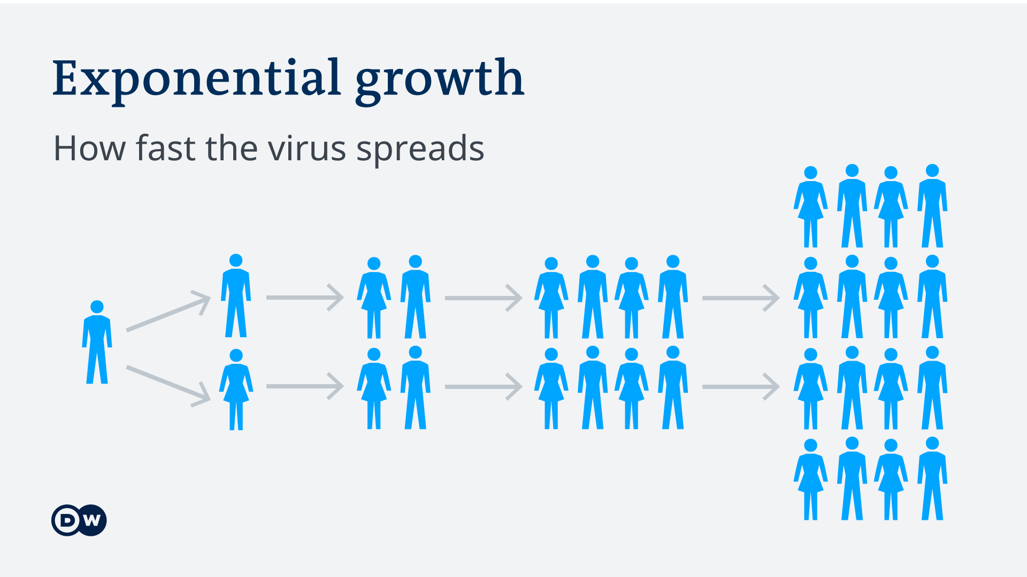
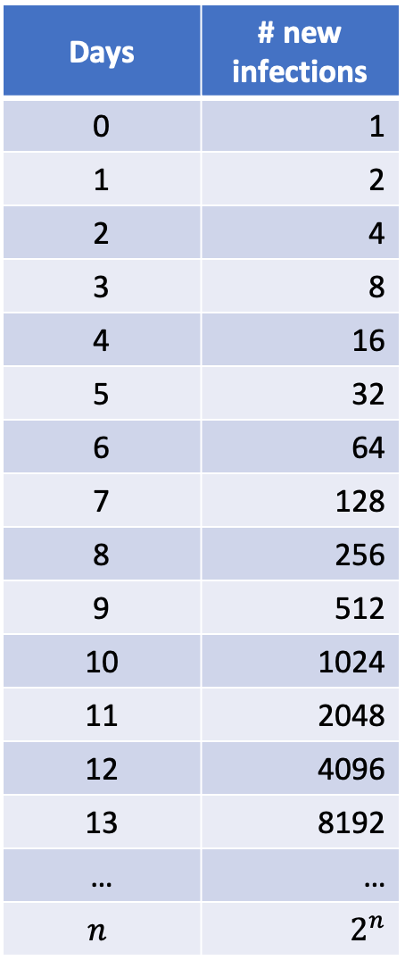
Exponential Functions
Days | # new infections
0 | 1
1 | 2
2 | 4
3 | 8
4 | 16
5 | 32
6 | 64
7 | 128
8 | 256
9 | 512
10 | 1024
11 | 2048
12 | 4096
13 | 8192
… | …
$$n$$ | $$2^{n}$$

Slide 3
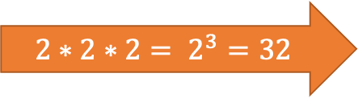
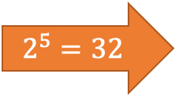

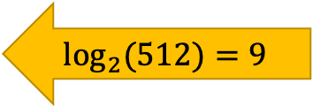
Exponentials & Logarithms
Days | # new infections
0 | 1
1 | 2
2 | 4
3 | 8
4 | 16
5 | 32
6 | 64
7 | 128
8 | 256
9 | 512
10 | 1024
11 | 2048
12 | 4096
13 | 8192
… | …
$$\log_{2}\left(x\right)=a ⇔ 2^{a}=x$$
$${2∗2∗2= 2}^{3}=32$$
Logarithms were invented for easy calculations
$$2^{5}=32$$
$$\log_{2}{(512)}=9$$

Slide 4

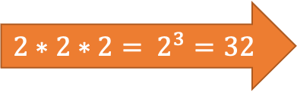

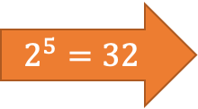


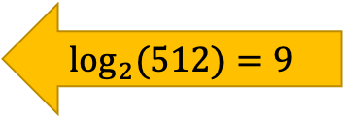

Exponentials & Logarithms
Days | # new infections
0 | 1
1 | 2
2 | 4
3 | 8
4 | 16
5 | 32
6 | 64
7 | 128
8 | 256
9 | 512
10 | 1024
11 | 2048
12 | 4096
13 | 8192
… | …
+1
$$×2$$
+1
$$×2$$
$$\log_{2}\left(x\right)=a ⇔ 2^{a}=x$$
+1
$$×2$$
$${2∗2∗2= 2}^{3}=32$$
$$\log\left(2^{x}\right)=\log_{2}\left(2^{x}\right)=x$$
Logarithms were invented for easy calculations
They translate multiplications into additions
$$2^{5}=32$$
$$512 × 8=2^{9} × 2^{3}=2^{9+3}=2^{12}=4096$$
$$2^{a}×2^{b}=2^{a+b}$$
$$\log_{2}{(512)}=9$$
$$\log\left(512 × 8\right)=\log\left(512\right)+\log\left(8\right)=9+3=12=log⁡(4096)$$
$$\log\left(c×d\right)=\log\left(c\right)+\log\left(d\right)$$

Slide 5
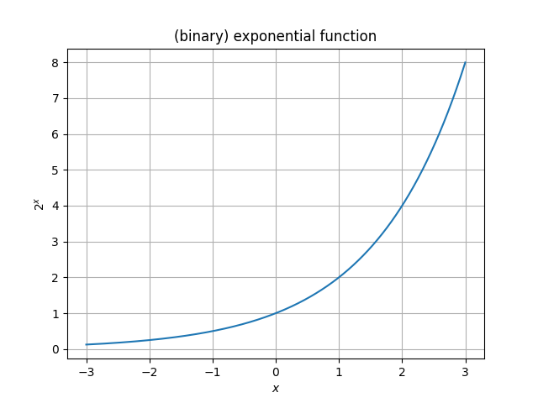
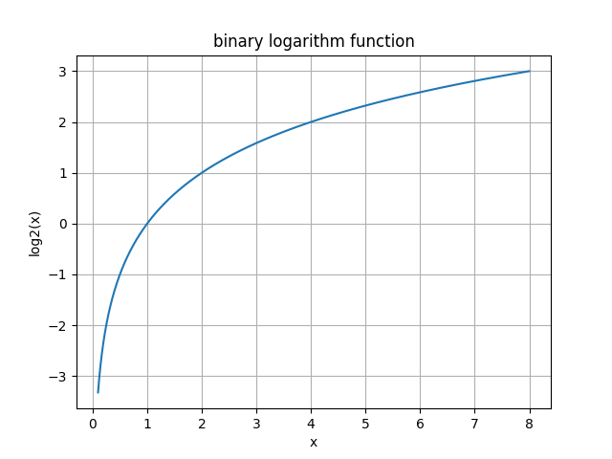
Exponentials & Logarithms
Days | # new infections
0 | 1
1 | 2
2 | 4
3 | 8
4 | 16
5 | 32
6 | 64
7 | 128
8 | 256
9 | 512
10 | 1024
11 | 2048
12 | 4096
13 | 8192
… | …
+1
$$×2$$
+1
$$×2$$
+1
$$×2$$
$${2∗2∗2= 2}^{3}=32$$
$$2^{5}=32$$
$$\log_{2}{(512)}=9$$

Slide 6
What will you Learn from this Talk?
Logarithms
Shannon Entropy
Data Compression
Error Correction

Slide 7
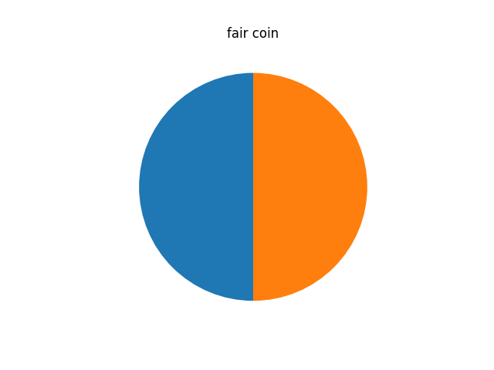
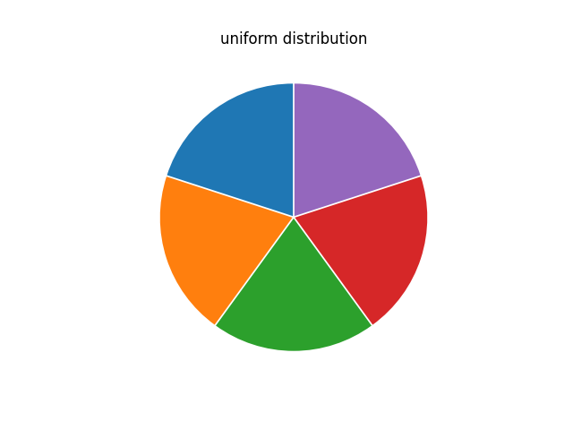
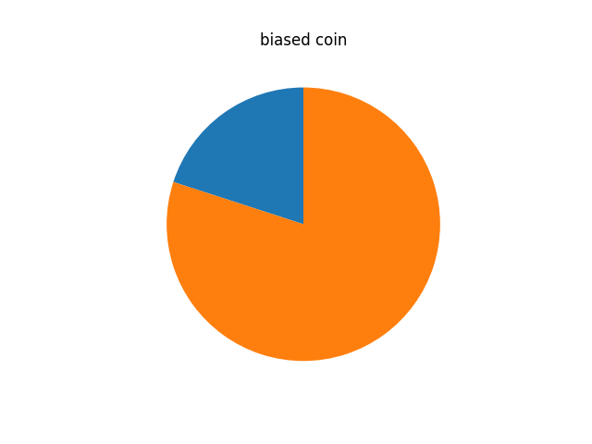
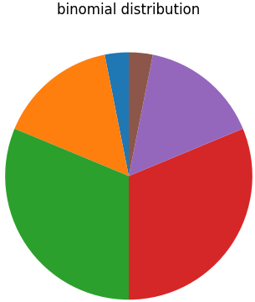
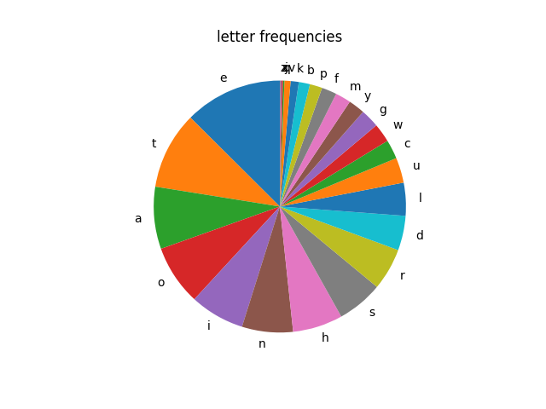
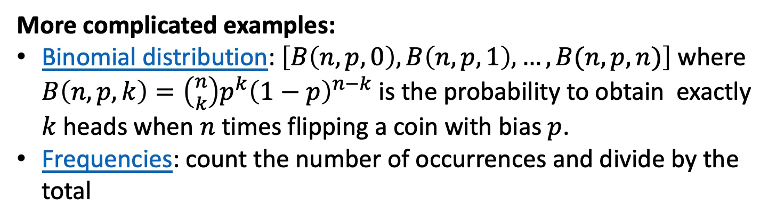
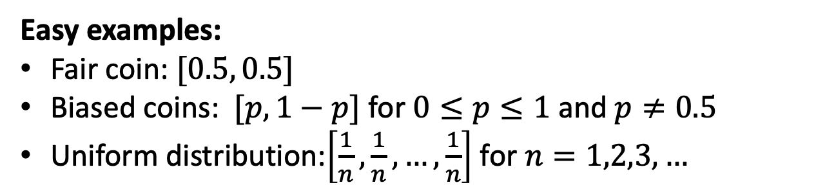
(Discrete) Probability Distributions
Definition: A list of non-negative numbers that sum to 1.
Easy examples:
Fair coin: $[0.5, 0.5]$
Biased coins: $[p, 1−p]$ for $0≤p≤1$ and $p≠0.5$
Uniform distribution:$\left[\frac{1}{n},\frac{1}{n}, …,\frac{1}{n}\right]$ for $n=1,2,3,…$
More complicated examples:
Binomial distribution: $\left[B\left(n,p,0\right),B\left(n,p,1\right), …, B(n,p,n)\right]$ where $B\left(n,p,k\right)=\left({n \atop k}\right)p^{k}{\left(1−p\right)}^{n−k}$ is the probability to obtain exactly $k$ heads when $n$ times flipping a coin with bias $p$.
Frequencies: count the number of occurrences and divide by the total

Slide 8
Sampling from Probability Distributions
Definition: A list of non-negative numbers that sum to 1.
Easy examples:
Explain how to sample from a given distribution by aligning the probabilities, throwing a random float between [0,1) and see in which interval it ends up.

Slide 9
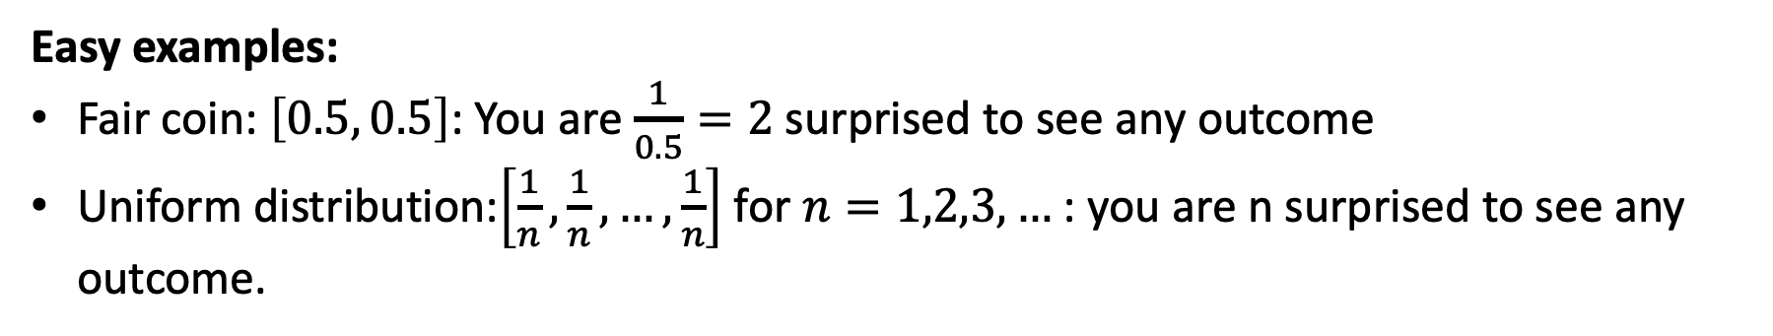
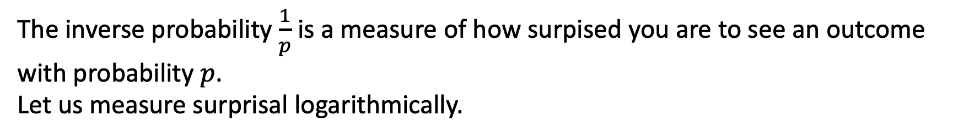
Surprisal
The inverse probability $\frac{1}{p}$ is a measure of how surpised you are to see an outcome with probability $p$.
Let us measure surprisal logarithmically.
Easy examples:
Fair coin: $\left[0.5, 0.5\right]$: You are $\frac{1}{0.5}=2$ surprised to see any outcome
Uniform distribution:$\left[\frac{1}{n},\frac{1}{n}, …,\frac{1}{n}\right]$ for $n=1,2,3,…$ : you are n surprised to see any outcome.

